Slide 1
WVD POC Notes From the Field

Slide 2
WVD Notes from the Field – POC Prep
User account/Service account that can join VMs to the domain
MUST NOT use MFA of any sort
Requires a complex password of at least 12 characters
Reference: https://richardstk.com/2013/11/29/create-a-dedicated-account-to-join-computers-to-a-domain/
VMs we spin up will need to be placed in an OU container; requires the distinguishedName of the OU (OU=HackWVD-Team1,OU=HACKWVD,DC=onprem,DC=hackwvd,DC=net)
Contributor or above (Owner) role(s) assigned at the Azure Subscription level
Designated Subnet per team for placement of the WVD VMs and the File Server hosting the FSLogix Profiles
File Server for hosting Profiles
Software to install on custom images available on a file server in Azure
Binaries for FSLogix (we need the agent in our VMs)
Copied the included ADMX and ADML files into your Active Directory environment: https://docs.microsoft.com/en-us/fslogix/use-group-policy-templates-ht
Use Extra Accounts for your Team to Test (e.g., use accounts a-d to build and e-g to test)
Service Principal for building WVD Host Pools – required in MFA-enabled environments
Grant other users participating in the WVD POC the “WVD Tenant Creator” Role

Slide 3
WVD Notes from the Field – PoC Success List
All the VMs we build will join Active Directory Domain – no blockers to joining for POC attendees
For the VMs we spin up, best to have Admin rights at the OS level; recommend we have a Domain Admin in the room (OU management rights)
All the work we do in WVD will be from Windows machines w/PowerShell– no Macs or other Linux systems.
PowerShell on Mac/Linux cannot be used to manage WVD; same with VS Code
Individuals managing WVD will need Admin rights on their local machines to add WVD binaries to PowerShell
It’s best to have GPO manipulation capabilities
GPOs for FSLogix
We sometimes run into a GPO blocker that requires remediation
See https://docs.microsoft.com/en-us/azure/virtual-desktop/overview for a list of URLs we need to be able to access over 443 & 1688
You will have to create a custom forced route to our KMS: https://docs.microsoft.com/en-us/azure/virtual-machines/troubleshooting/custom-routes-enable-kms-activation
Best to have ability to manipulate host-based Firewall on the VMs just in case there are exclude rules hindering communications
Check Subscription Core Counts – ensure both Regional and VM types have headroom

Slide 4
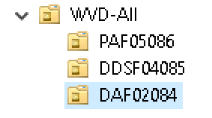
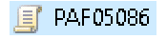


Deploy Common Names across OU’s, GPO’s, Resource Groups, HostPools & VM Names in AD
Create an OU Structure
Naming convention is OU, HostPool, Share, and VM Name all match
3. Create GPO’s for each OU w/the same name
4. GPO points to FSL Profile share w/same name
5. Create a HostPool of the same name that populates the OU
a. Deploy to Resource Group of the same name PAF05086
6. Name VMs with same name
VM NetBIOS names are PAF05086-0, -1, etc.
\\FSLFS\Share\PAF05086
PAF05086 Host Pool
Block Inheritance Here
Name is consistent across all components – easy to see which parts are related

Slide 5
Allow Office Activation to Roam w/User
Reference: https://docs.microsoft.com/en-us/DeployOffice/overview-of-shared-computer-activation-for-office-365-proplus
Users can activate Office 365 ProPlus only on a limited number of devices, such as 5 PCs.
Gallery Multi-User Win10 Images in Azure w/O365 ship with Shared Computer Activation (SCA) - doesn't count against that limit
Alternatively, you can “clean” install O365 and enable SCA
3 steps required to enable Office Activation to roam:
[Note that the O365 Container is separate from the Profile Container]
In O365 Containers node, change “Enabled” key from “Not Configured” to “Enabled”
Enable “VHD Location” key and provide a path to a file share on FSLogix Server
Set “Include Office activation data in the container” to Enabled

Slide 6
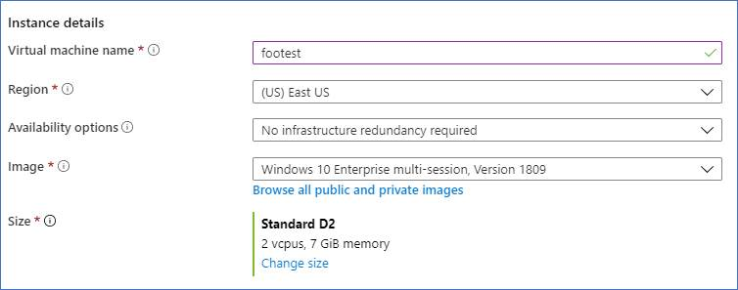
Plan to build a Gold Image VM from Scratch – Choose the Correct OS
Create a VM from a managed image
Build the VM like you would any other (we’re not creating anything WVD-centric at this point, just a VM to customize)
Region is the same as where you are deploying WVD HostPools, Subnets in same Region
Ensure this is the version showing
Browse to find it….

Slide 7
Gold Image Build - Customize the VM
Login to the VM you just created and configure it how you like
Guides:
Software preparation and installation – MS Guidance
https://www.robinhobo.com/how-to-create-a-custom-windows-10-multi-user-image-with-lob-applications-for-windows-virtual-desktop-preview-wvd-hostpool-deployments/ (3rd party, but great!)
Key configs:
VERY important to get Office & OneDrive deployed per-machine
Install OneDrive in per-machine mode
Install Office in shared computer activation mode
VERY important to register VM with Azure-based KMS
Code: Invoke-Expression "$env:windir\system32\cscript.exe $env:windir\system32\slmgr.vbs /skms kms.core.windows.net:1688"
DO NOT EVER activate manually w/an on-prem, non-multi-user Key (it will change VM forever to single-user)
Don’t forget your GPU drivers: https://docs.microsoft.com/en-us/azure/virtual-desktop/configure-vm-gpu
Popular Add-Ons:
FSLogix agent to achieve persistent user experience across VMs (Profile and Office cache)
WVD Full client to put Remote Apps in the Start Menu
Institutional antivirus
Management / monitoring tools
Sepago Agent for monitoring VMs
Nerdio for Azure – WVD management, imaging, and deployment management tools

Slide 8
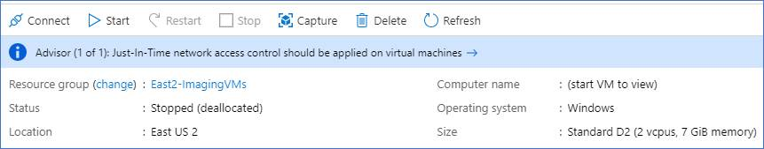
Gold Image Build - Turn the VM Into an Azure Image
Once done with customization:
Sysprep the system and shut it down
Verify in the Azure console VM is “Stopped (deallocated)”
Ref: https://docs.microsoft.com/en-us/azure/virtual-machines/windows/capture-image-resource
After VM shut down select “Capture” on the VM’s management page:

Slide 9
Profile IOPS Planning Guidance
IOPS impacts on a VM are:
1.5-3 IOPS per App Pool
3-8 IOPS per Desktop pool
Logon/logoff will multiply each number between 5x and 10x IOPS
This is a planning estimate w/o knowing anything about workloads

Slide 10
WVD Best Practices

Slide 11
Short List of WVD Best Practices (1 of 3)
Publish Apps where you need to, publish Desktops where you must
Apps put less pressure on VMs, have lower bandwidth requirements at the endpoint
Full Desktop is useless on some devices (e.g. an iPad mini user does not want a Windows desktop)
Full Desktop is harder to get “right” due to many look and feel options (must involve Desktop Management team to resolve)
Publish mission-critical apps first, including Browser links to internal apps that are on-prem (super easy to do in WVD)
Deploy the RDClient as a published App - Admins can connect to WVD and then RDP to whatever systems they need (again, this is how Microsoft deployed our WVD solution)
This is how Microsoft deployed WVD to our users – we voted with our feet
Use fewer, larger (CPU, memory) WVD systems with best I/O (Premium Disk, Accelerated Networking) not more numerous, smaller systems
Use Sepago Agent w/Log Analytics back-end to monitor WVD VMs for performance http://loganalytics.sepago.com/
GPO Guidance:
Block GPO inheritance at the root OU for WVD - GPO’s may enforce KMS and other settings we do not want
Remove any Login banners for App Host Pools
Deploy each WVD HostPool to its own OU w/its own unique GPO
GPO settings applied for each OU point to a Share designated for that HostPool’s FSLogix profile disks (One for Office, one for Profile)
Use a consistent naming convention across OU’s, GPO’s, FSLogix Shares, Resource Group, and VM names; makes it easy to show inter-relationships

Slide 12
Short List of WVD Best Practices (2 of 3)
FSLogix:
Ensure Antivirus software on FSLogix Profile Servers is not scanning the VHD(x) files hosted for end-users (set relevant exclusions)
Calculate IOPS demands – examine ANF as a solution vs. File Servers
Deploy Profile disks per HostPool
Run Office locally on the endpoint device
Each endpoint can get a version of Office that is “tuned” for the device’s interface (e.g. Office version on iPad is built for the touch interface)
Leverages local horsepower and investment in the device, vs. pushing WVD to perform all processing
Do Not run Teams or any other telecom app in WVD
Teams is not officially supported in WVD yet – it will be soon
Each telecom app is built with a given interface in mind, as well as the ability to leverage attached devices (speakerphones, etc.) natively
More efficient for telecom traffic to move directly between the endpoint and the teleconference service, vs. round-tripping communication back and forth to Azure, then from Azure back & forth to/from the telecom service
Latency incurred can be damaging to teleconference experience / most will not work at all
Use Azure Bastion to access VMs directly from portal when troubleshooting

Slide 13






Azure Bastion
Customer’s Virtual Network
Private IP
Secure and seamless RDP and SSH access to virtual machines – Leverage this for direct VM Login (bypasses WVD PaaS layer)
Port: 3389/22
“AzureBastionSubnet”
Azure VM
SSL
GA
Remote Protocol
(RDP, SSH, et al)
RDP/SSH to your VMs using HTML5 standards-based web-browser, directly in Azure Portal
Resources can be accessed without public IP addresses
Supported Azure resources include VMs, VM Scale Sets, Dev-Test Labs
Azure VM
Azure Portal
SSL
443, Internet
Azure VM
Azure Bastion
AzureBastionSubnet
Target VM Subnet(s)

Slide 14
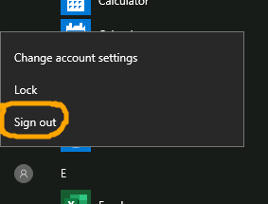
Short List of WVD Best Practices (3 of 3)
Logoff:
Disconnected and idle sessions exist indefinitely by default
Set limits w/Group Policy Object:
Computer Configuration > Policies > Administrative Templates > Windows Components > Remote Desktop Services > Remote Desktop Session Hosts > Session Time Limits
Enable and set the limit for disconnected sessions and limit for active but idle RDS sessions. Exact limits vary by environment.
Teach users to logoff properly
Use Accelerated Networking on WVD VMs and File Servers in Azure (hosting either/or Profiles or user files)
Expedites network flow to/from FSLogix and WVD Systems
az vm deallocate --resource-group myRG --name myVM
az network nic update --name myNic --resource-group myRG --accelerated-networking true
az vm start --resource-group myRG --name myVM

Slide 15
Sustainment / Refinement Steps

Slide 16
Create a Custom URL for your WVD Deployment
http://xenithit.blogspot.com/2020/02/create-corporate-url-for-windows.html
WVD HTML5 client uses a Microsoft URL which is long and also is the exact same for every customer:
https://rdweb.wvd.microsoft.com/webclient/index.html
Alternatively, you can use https://aka.ms/wvdweb
What would be better is to use a URL that looks something like https://myapps.contoso.com
There are two very simple methods to achieve this, the first is using an Azure Function App, the second is to use Azure Front Door
more details on AFD are in the article
An Azure Function App will require a tiny bit of code but can be free to use; Azure Front door does not require any coding at all for this capability, but will always have a cost
This article describes how to do this using a Function App, and will guide you through how to set this up
One of the great things about Function Apps is that the first 1,000,000 executions are free which is very handy

Slide 17
Build a Custom WVD Deployment Template (raw)
https://raw.githubusercontent.com/Azure/RDS-Templates/wvd-templates_preview_20200402.1900.0/wvd-templates/Create%20and%20provision%20WVD%20host%20pool/mainTemplate.json
This is the value to use for the _artifactsLocation parameter https://raw.githubusercontent.com/Azure/RDS-Templates/wvd-templates_preview_20200402.1900.0/wvd-templates/

Slide 18
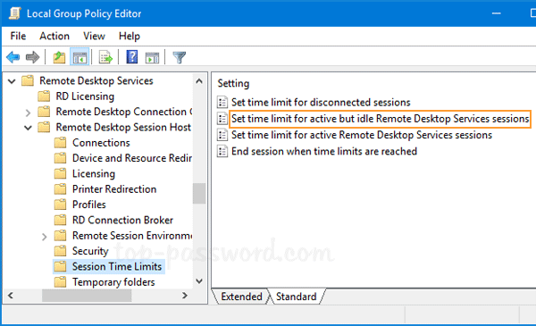
Adjust Idle Session Logoff
Disconnected and idle sessions will exist indefinitely without intervention
Set limits on idle and disconnected sessions with a Group Policy Object
Create a GPO and modify the settings under
Computer Configuration > Policies > Administrative Templates > Windows Components > Remote Desktop Services > Remote Desktop Session Hosts > Session Time Limits
Enable and set the limit for disconnected sessions and limit for active but idle RDS sessions. Exact limits vary by environment.

Slide 19
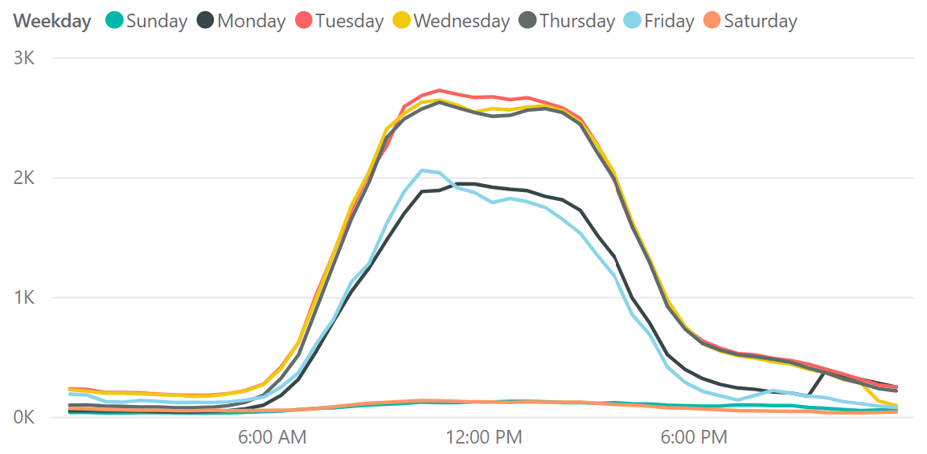
Scale based on schedule and load
1
Schedule VMs to start and stop based on Peak and Off-Peak business hours
2
Scale out VMs based on number of sessions per CPU core
Scale in VMs during Off-Peak hours, leaving the minimum number of session host VMs running
3

Slide 20
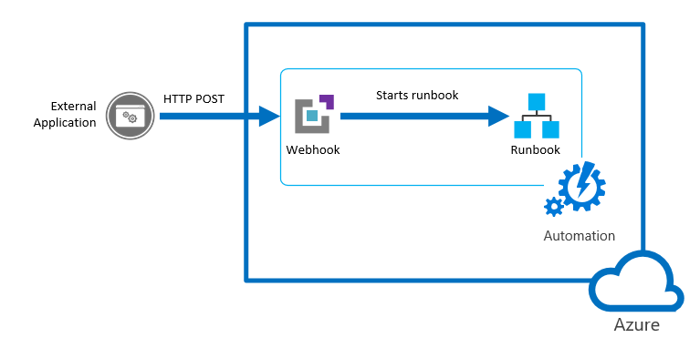



Scaling Windows Virtual Desktop with Azure Automation
Azure Logic Apps
WVD Host Pool
WVD Scaling logic

Slide 21
Scaling up and Down and/or Adding Hosts to WVD
Start/Stop serverless automation on Host Pool VMs https://docs.microsoft.com/en-us/azure/virtual-desktop/set-up-scaling-script
Scales WITHIN Host Pool turning on/off VMs in the Pool
Low-cost automation option to optimize session host VM costs:
Schedule VMs to start and stop based on Peak and Off-Peak business hours
Scale out VMs based on number of sessions per CPU core
Scale in VMs during Off-Peak hours, leaving the minimum number of session host VMs running
Mandates changing from Breadth Mode to Depth Mode (next slides)
Adding Hosts is separate from Scaling within Host Pools
Scaling Within Host Pool Limits
Add More Hosts
Expand an existing host pool with new session hosts
…..

Slide 22


Optimizing load balancing
4
5
2
1
2
3
1
3
Breadth-first load balancing
Distributes new user sessions across all available session hosts in the host pool
Depth-first load balancing
Distributes new user sessions to an available session host with the highest number of connections but has not reached its maximum session limit threshold

Slide 23
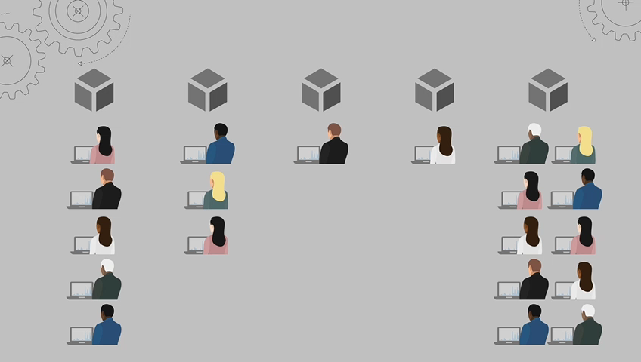
Breadth Mode Deployments: Set-RdsHostPool [-TenantName] <string> [-Name] <string> [-BreadthFirstLoadBalancer] [-MaxSessionlimit <int>]
User will land on the session host that has the least number of connected user sessions
Achieves optimal distribution across all available Hosts

Slide 24
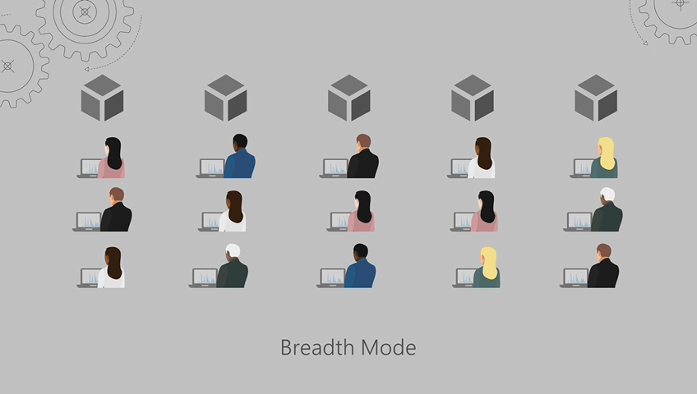
Depth Mode Deployments: Set-RdsHostPool [-TenantName] <string> [-Name] <string> [-DepthFirstLoadBalancer] -MaxSessionlimit <int>
User will land on the session host that has the highest number of user sessions (autoscale adds nodes based on demand)
Used in concert w/AutoScale Scripts to achieve siloed distribution

Slide 25
Swapping in a New Gold Image for a Host Pool
Use this GitHub Template: https://github.com/Azure/RDS-Templates/tree/master/wvd-templates/Update%20existing%20WVD%20host%20pool
Removes or stops old WVD Hostpool session hosts
Creates new VMs & registers them to WVD host pool
ActionOnPreviousVirtualMachines Parameter:
Delete - previous session host VMs will be deleted, along with the associated network interfaces and OS disk
Deallocate - Azure VMs (hosts) will be removed from HostPool and simply de-allocated in Azure, allowing you to preserve or connect to them later

Slide 26
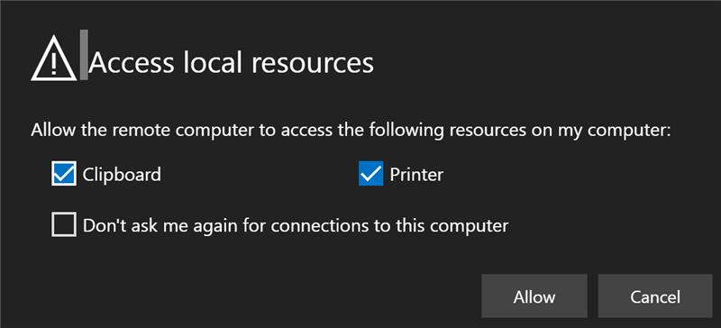
Make the banner for 'Access local resources' go away...
$properties="redirectprinters:i:0;redirectclipboard:i:0"
Set-RdsHostPool -TenantName <tenantname> -Name <hostpoolname> -CustomRdpProperty $properties

Slide 27
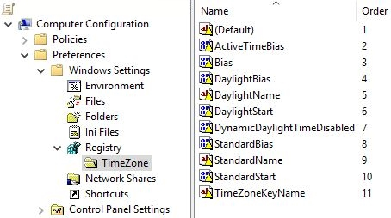
Set WVD VM Time Zone via GPO & Disable AAD Joins
Reference: https://dennisspan.com/configuring-the-time-zone-and-code-page-with-group-policy/
HKLM\SOFTWARE\Policies\Microsoft\Windows\WorkplaceJoin
REG_DWORD BlockAADWorkplaceJoin=1

Slide 28
Allow iOS and macOS to log in with email (rather than the full URL)
https://docs.microsoft.com/en-us/windows-server/remote/remote-desktop-services/rds-email-discovery
Set up _msradc txt record in DNS pointing to our rdweb.wvd.microsoft.com url

Slide 29
Optimizing Costs – When to Use Reserved Instances
Pay-As-You-Go
Azure Reserved VM Instances (RI)
Pooled desktops
Personal desktops
Use Azure Automation to optimize multi-session and single-session pooled desktops
Predictable usage patterns
Utilization
Utilization
When VM usage is
>400 hours/month→ 1-year RI >240 hours/month → 3-year RI
Ideal for session state retention and
Always-on experience

Slide 30
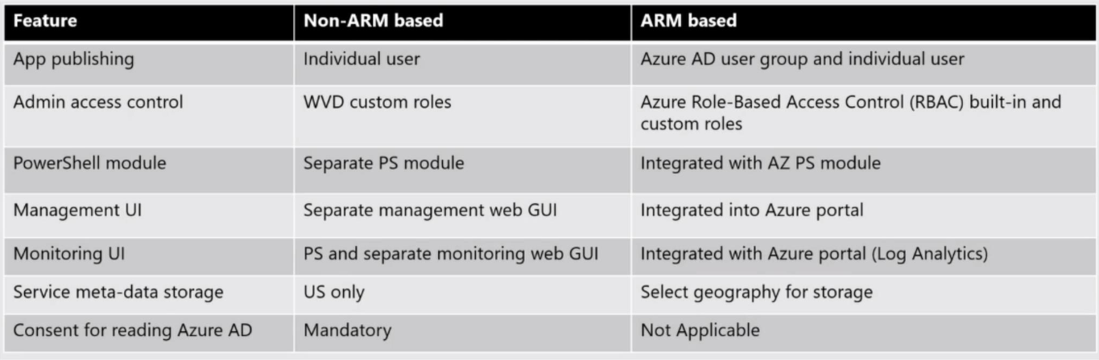
WVD V2 Is Coming… (May 2020)

